Slide 1
ZF Engineering Company presentation

Slide 2
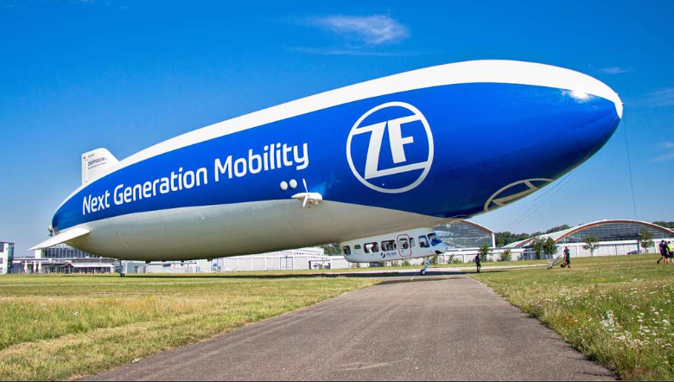
Agenda
ZF company
ZF Engineering Plzeň s.r.o.
ZF Engineering Plzeň s.r.o. – branch in Zlin
Projects and cooperation
Company culture
Future cooperation
Questions

Slide 3
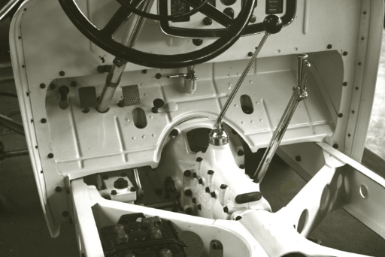
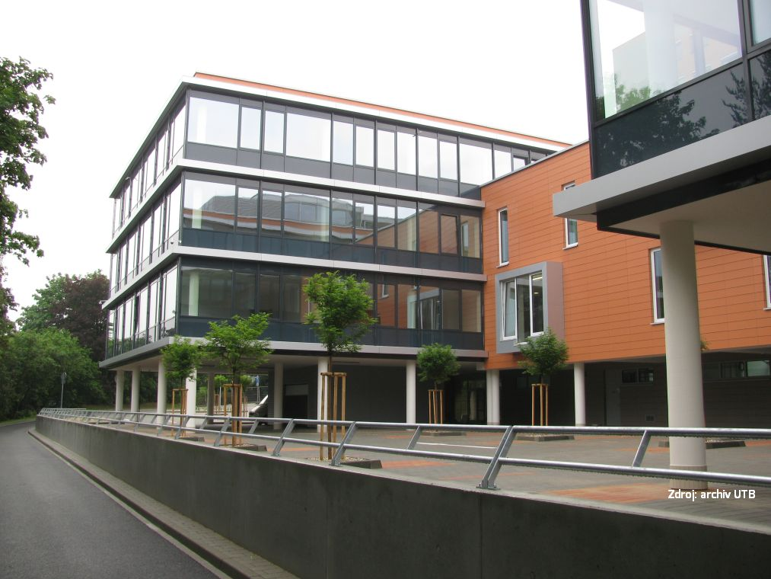
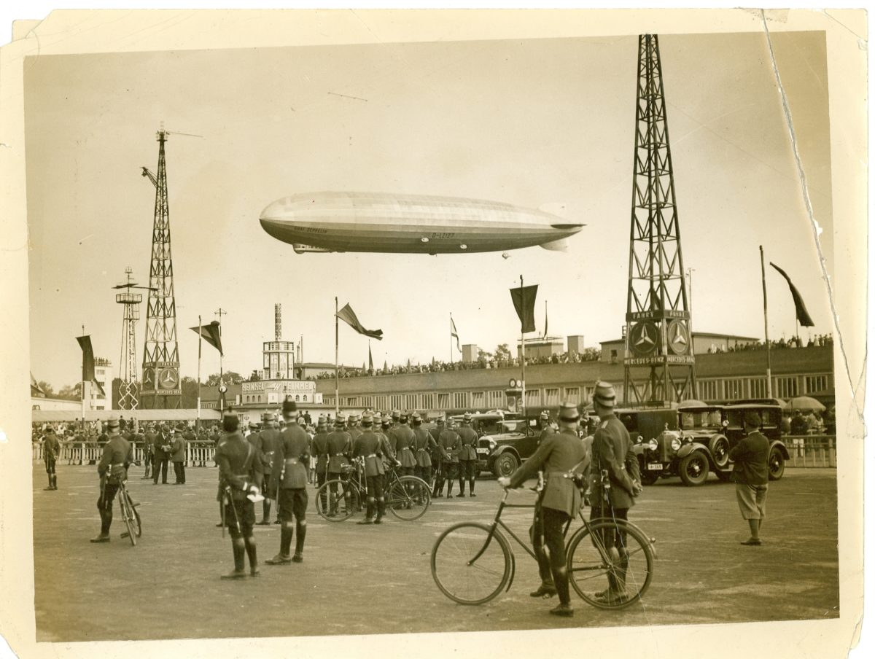
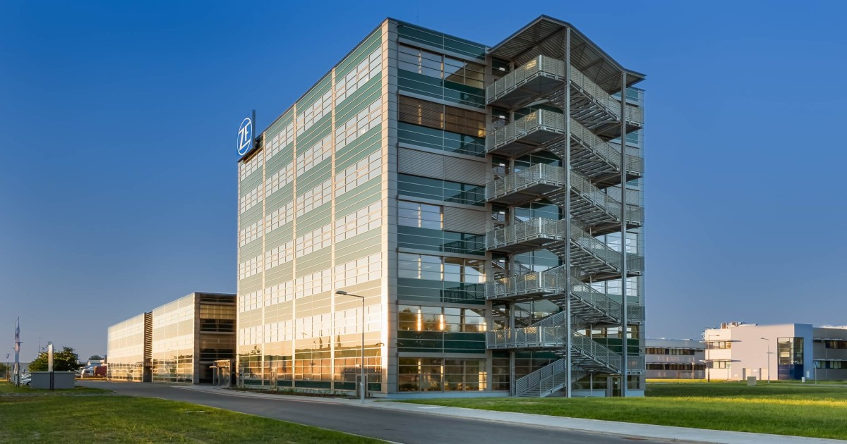
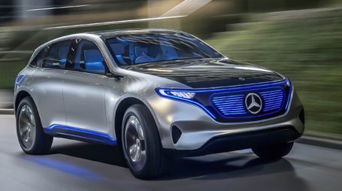
ZF Milestones
1925
1969
1999
2006
2018
1915
1961
1991
2001
2007
2019

Slide 4
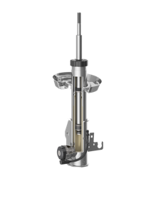
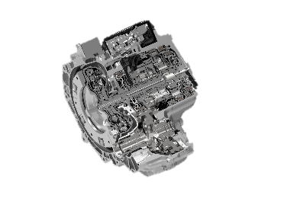
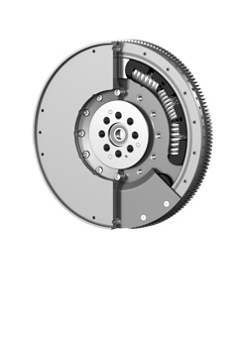
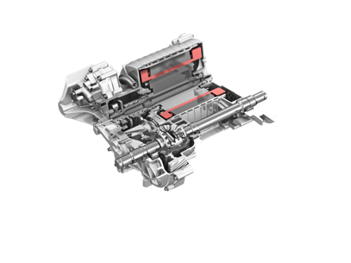
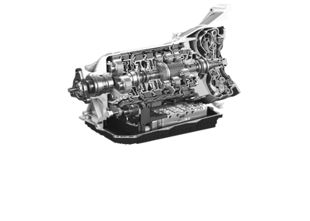
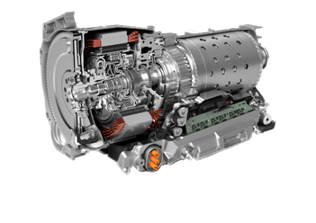
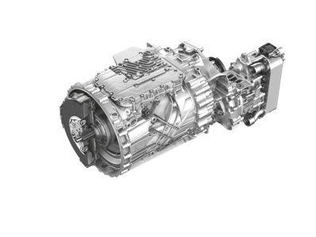
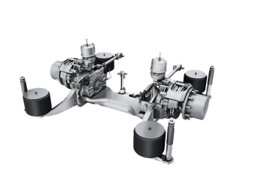
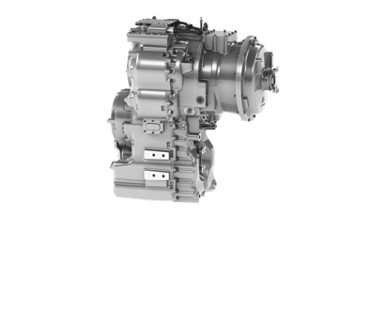
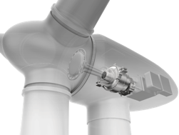
ZF products we are contributing to with engineering work
Passenger cars:
8HP transmission EVD electric drive CDC damping control 8P4G Hybrid transmission 9HP transmission Dual mass flywheel
Trucks, buses, boats, industry:
Traxon transmission Truck clutch AVE130 electric drive for city bus Ergo power transmission Wind power transmission
Notes:
5.4.21 - Replace heli by wind power transmission
Replace / modify pictures for blue background

Slide 5
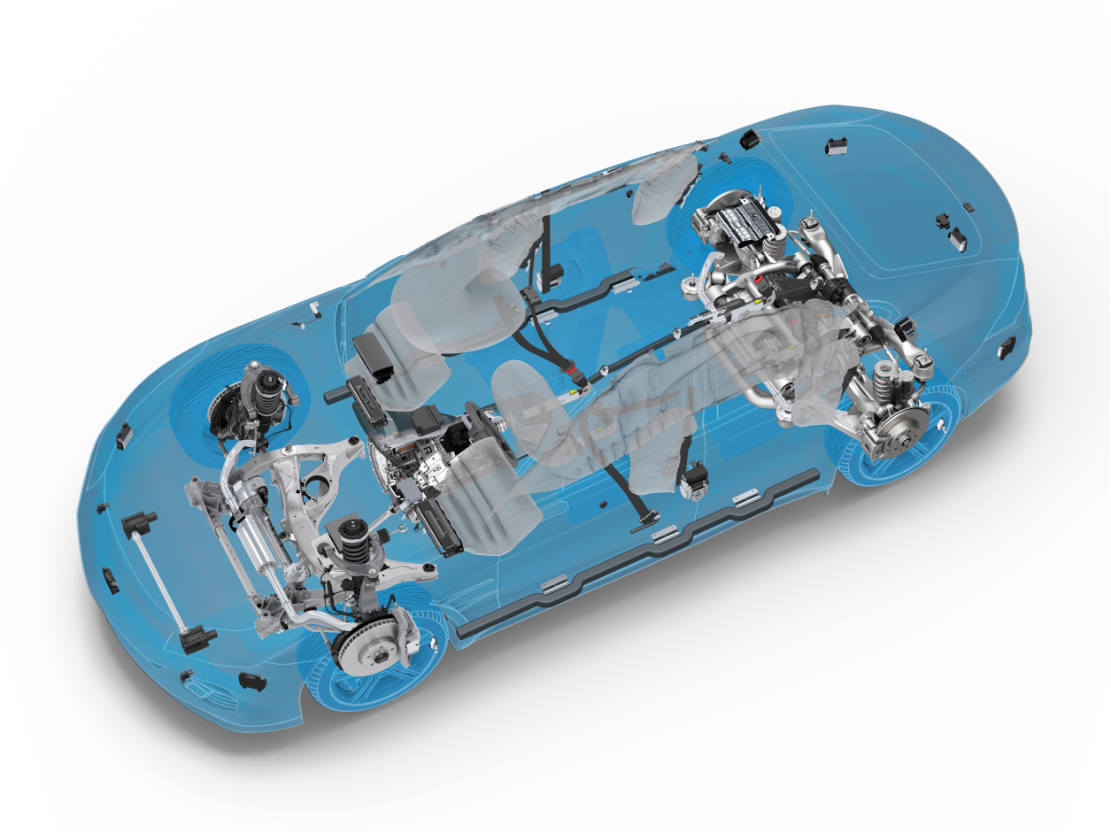
ZF Systems Expertise
Occupant Safety Systems
Active Chassis Systems
Advanced Driver
Assistance Systems
Axle Drives /
Electric Axle Drives
Chassis Components
Axle Systems
Electric Drives
Braking Systems
Steering Systems
Transmission Systems
Damping Systems
Safety Electronics
Electronic Systems
Electrified Powertrain:
Vehicle Motion Control:
Automated Driving:
Integrated Safety:

Slide 6
ZF locations in the Czech Republic in 2021: 3614 employees
1. | Tech Center Czech (R&D)
2. | Tech Center Czech (SW Development)
3. | Connectivity solutions
4. | Industry products assembly
5. | Aftermarket products production
6. | Brakes Production & Engineering
7. | Occupant Safety Systems Production
8. | Corner modules Assembly
9. | Electronic Systems Production
10. | CVS office
11. | CVS office
5 ZF Automotive Czech s.r.o.
Frýdlant
8 ZF Chassis Systems Žatec s.r.o.
Žatec
POLAND
9 ZF Electronics Klášterec s.r.o.
Klášterec nad Ohří
6 ZF Automotive Czech s.r.o.
Jablonec nad Nisou
Praha
7 ZF Passive Safety Czech s.r.o.
Stará Boleslav
1 ZF Engineering Plzeň s.r.o.
3 ZF Openmatics s.r.o.
Plzeň
10 CVS office
Praha
4 ZF Staňkov s.r.o.
Staňkov
2 ZF Engineering Plzeň s.r.o.
Zlín
Brno
GERMANY
11 CVS office
Brno
AUSTRIA
SLOVAKIA
Notes:
Update 21-01-2022: Marta Surowiec does not have the info yet and she instructed us not to share these numbers externally.

Slide 7
Key Figures – Locations
North America
Locations: 41
Employees: 34,027
Europe
Locations: 95 Employees: 92,393
Asia-Pacific
Locations: 42
Employees: 25,168
188 | production locations in 31 countries
18 | main development locations in 8 countries
157 549 | Employees worldwide
Africa
Locations: 3
Employees: 596
South America
Locations: 7
Employees: 5,365
Worldwide Presence – Production, Development, Sales and Service

Slide 8
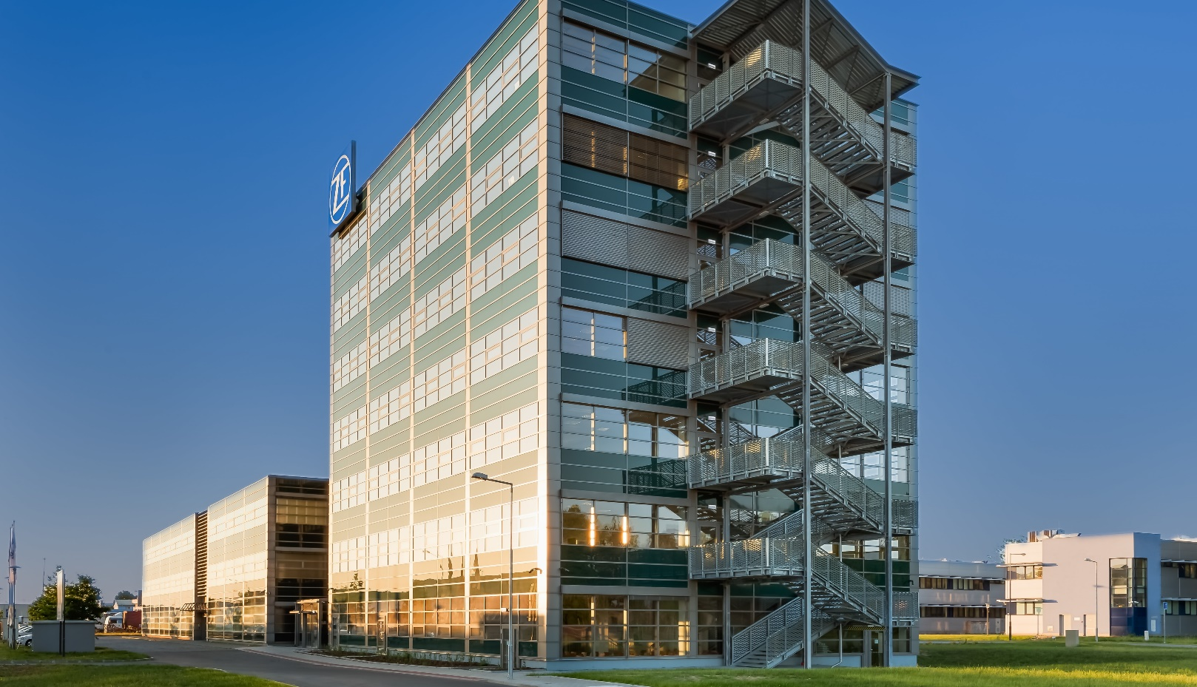
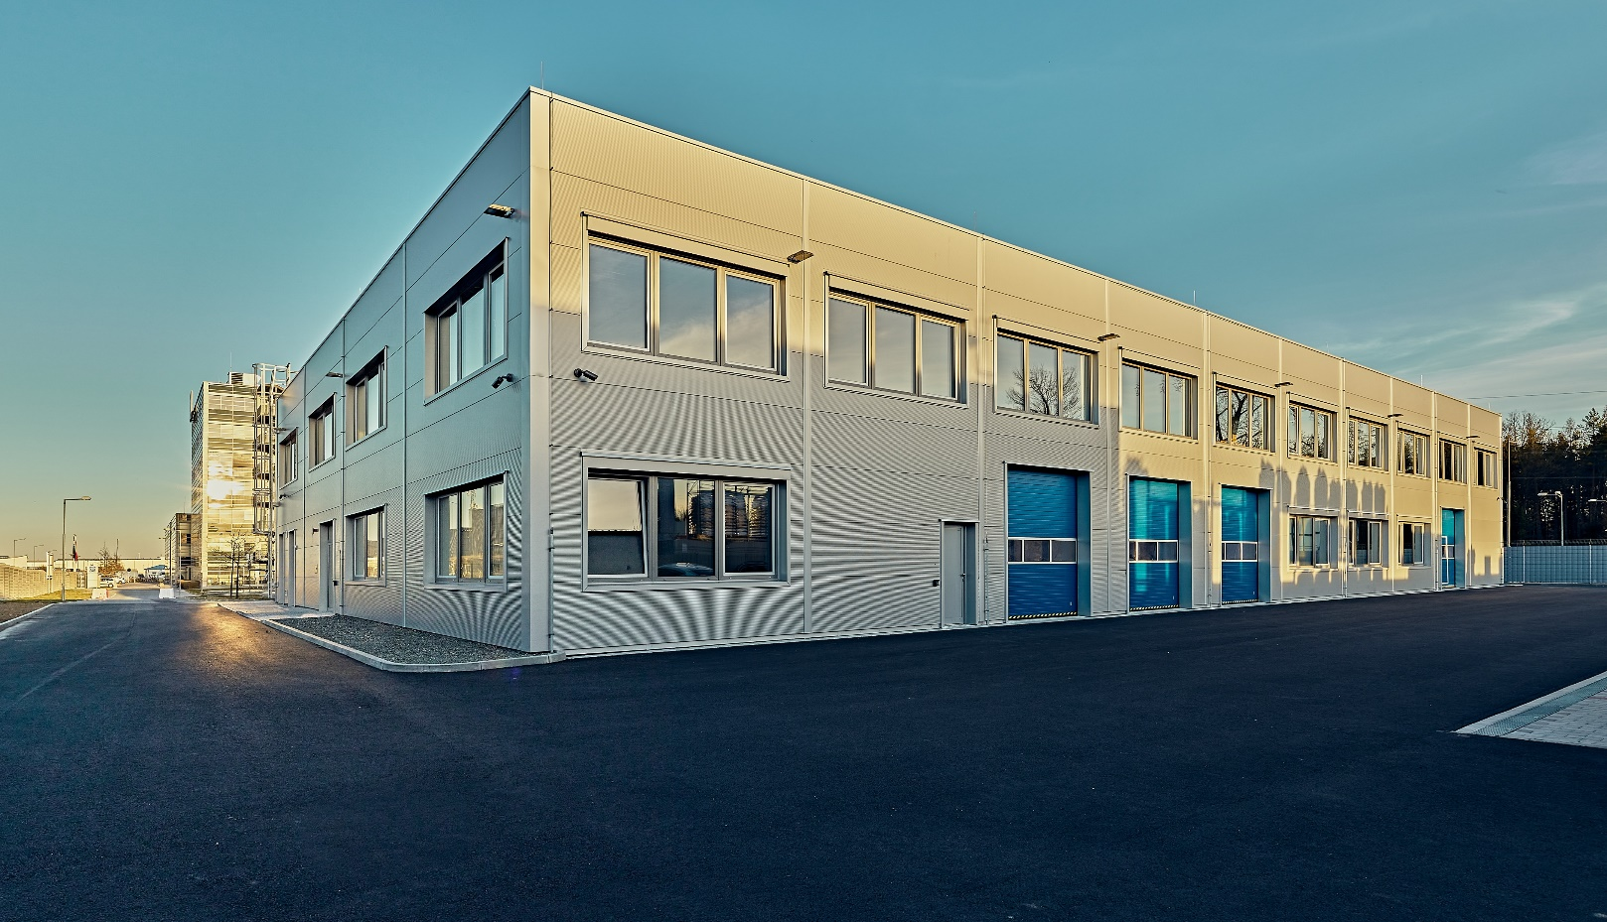
ZF Engineering Plzeň s.r.o.
Location Plzeň
Key figures Founded: 2007 Associates: 829 HC
We provide R&D Services for ZF group System Engineering Software Development and Testing HW Electronics and Mechatronics Development and Testing Mechanical Design and Simulation Rapid Prototyping and 3D Metal Printing
Other things to know about Awarded „Employer of the year“ in 2019, 2020, 2021, 2022, 2023 Cooperation with Universities in Pilsen, Zlín, Prague or Brno

Slide 9
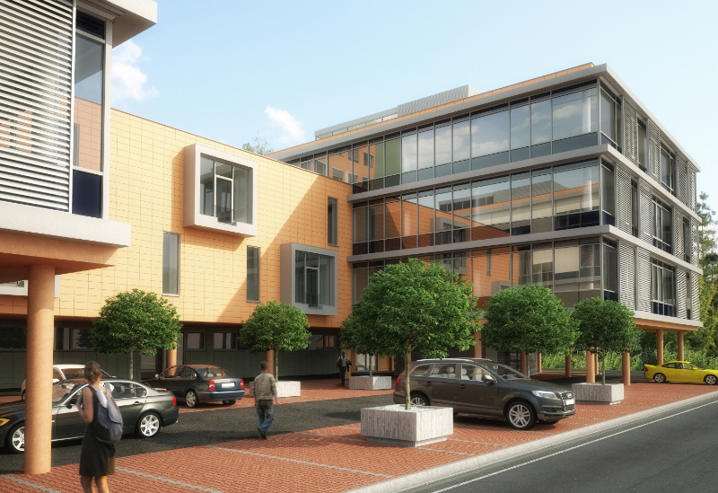
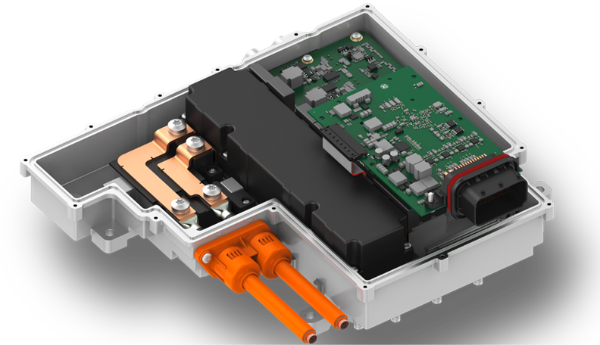
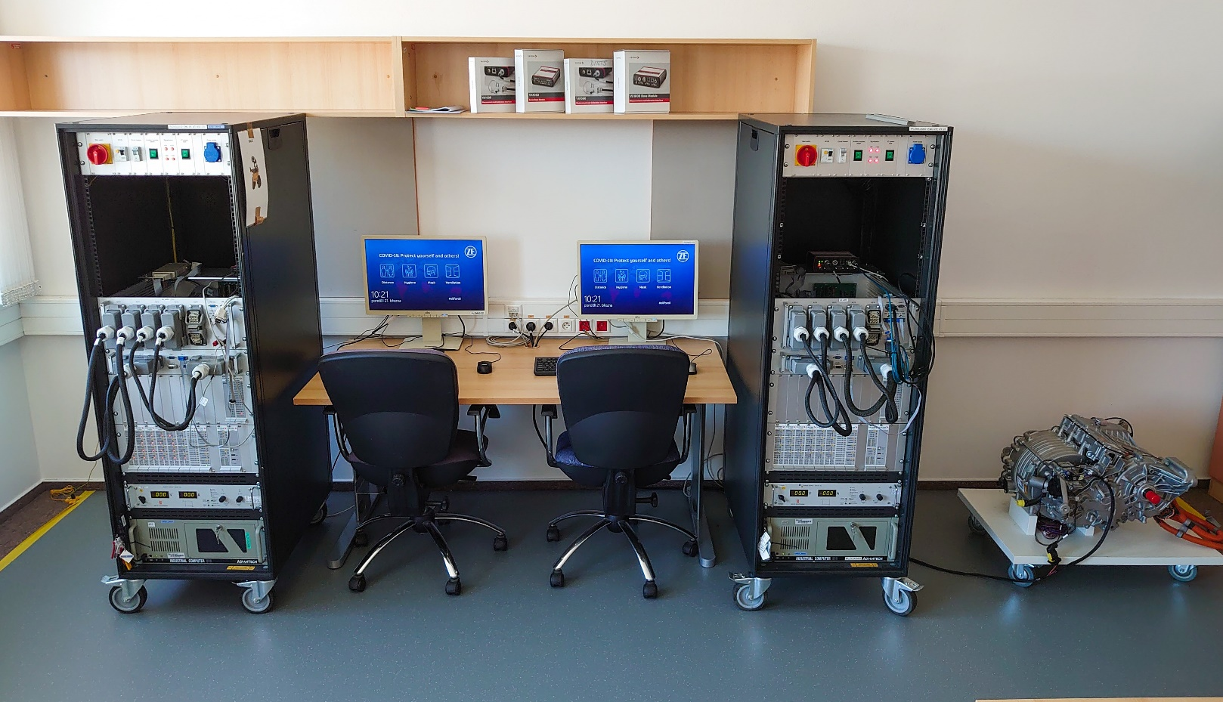
Zlín branch office
Locations Zlín Floor space : 660 m² -> 825 m² (from Feb 2023)
Key figures Founded: 2018 Associates: 75 HC (9/2024)
We provide R&D Services for ZF group Development (C and C++), cyber security, SW coordination, testing, process quality in E-mobility branch, simulations and mechatronics SW support for ZF plant(s) „EOL SW“ Support of other disciplines located in Pilsen
Other things to know about Cooperation with Universities in Zlín, Brno

Slide 10
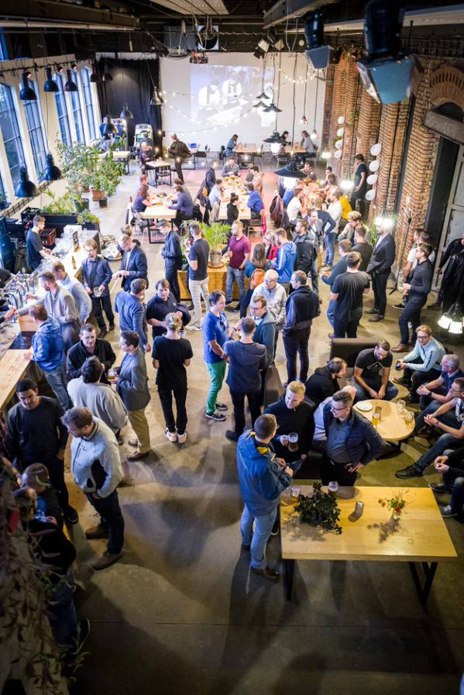
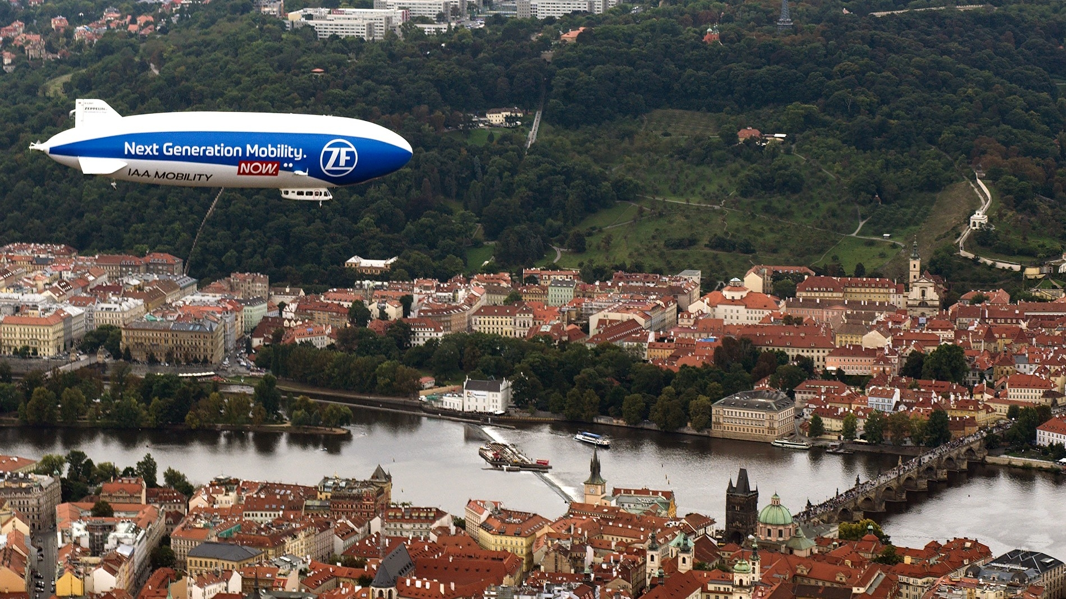
Company culture
Teambuildings, X-mas parties
Anniversary celebrations
Pub quizes
Marathon runs, …

Slide 11
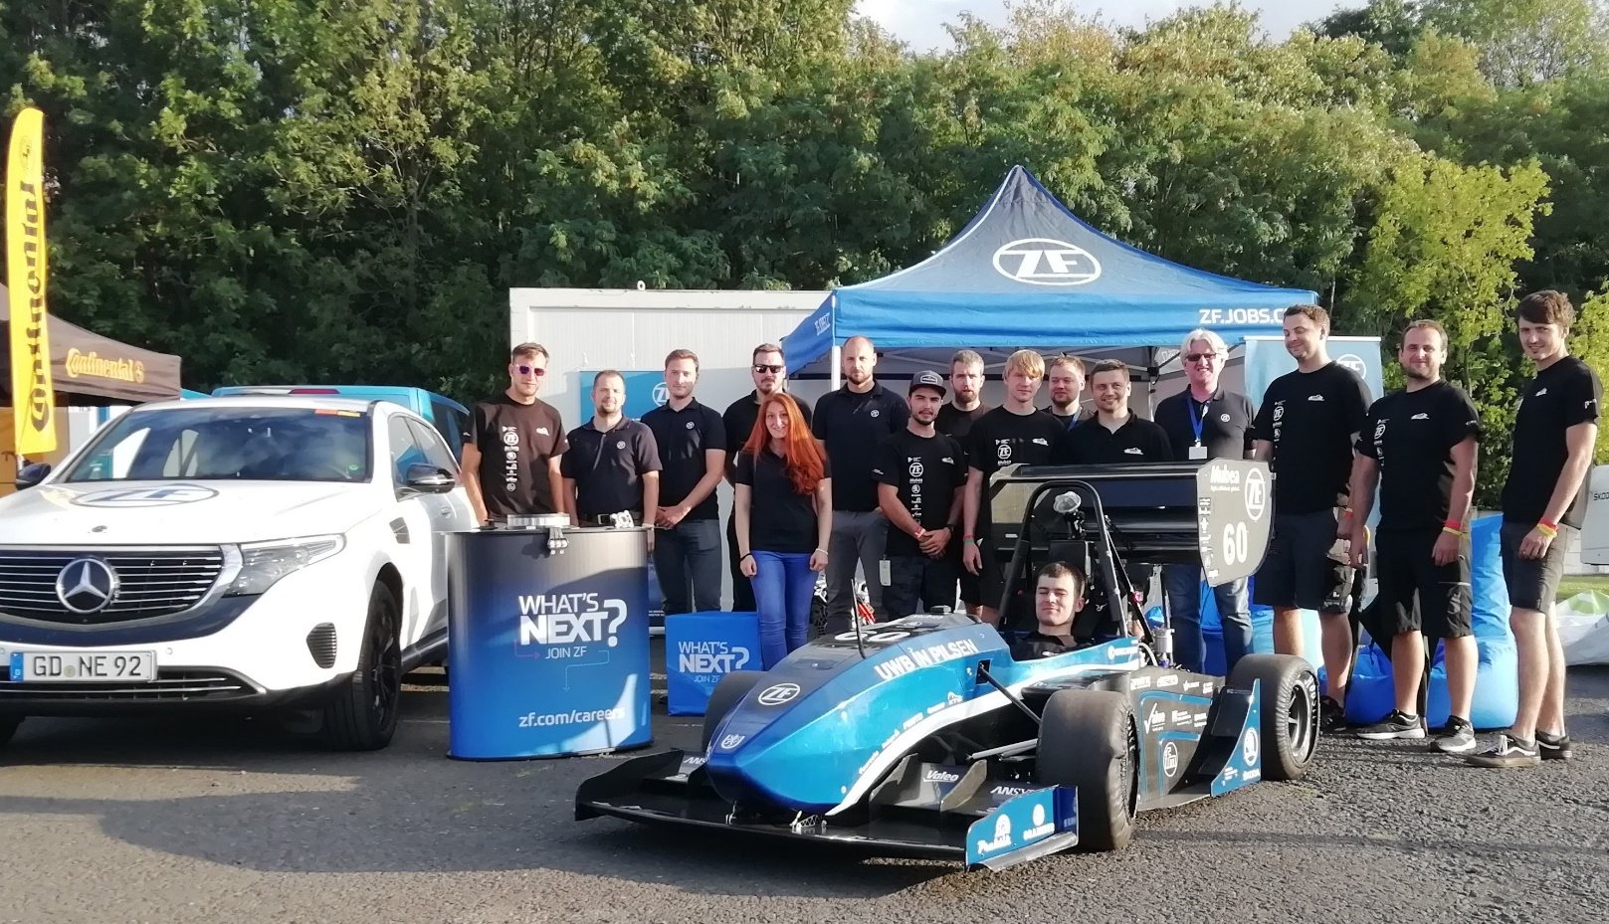
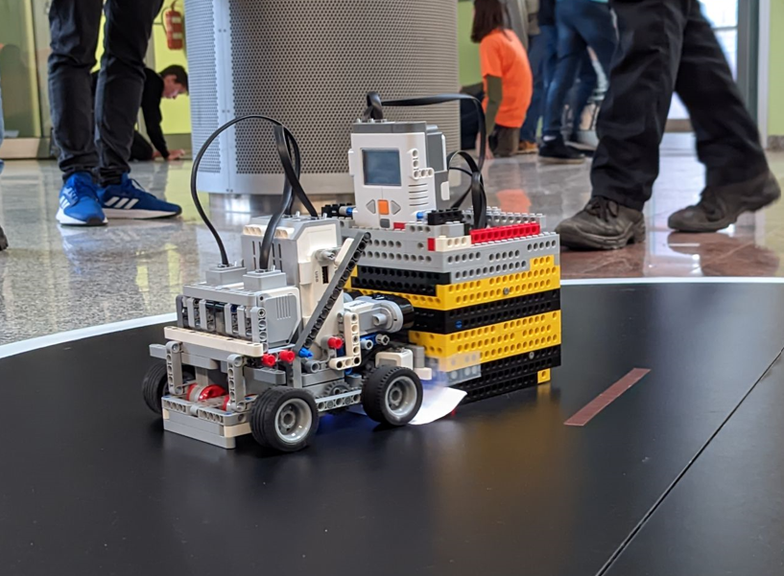
Partnership
Partnership and cooperation with students racing car teams
Partner of UTB Robo-games
Partner of „Soutěž Studentské tvůrčí a odborné činnosti (STOČ)“
Diploma & bachelor thesis - Actually 2 UTB students are working on bachelor thesis in cooperation with ZF

Slide 12
Bachelor & diploma thesis
Bachelor thesis
Kvantová výpočetní síla v AI: VQE jako nástroj pro optimalizaci generativních adversariálních sítí
Analýza rizik a hodnocení hrozeb v automobilovém průmyslu
Diploma thesis
Aplikace pro správu paměťových bloků v řídících jednotkách elektrického pohonu
Aplikace pro návrh a řešení elektrických obvodů
… in case of any interest, ZF is open to support students with other topics for bachelor & diploma thesis …

Slide 13
Q&A
Thanks for your attention

Slide 14
Appendix – links to promo videos
We are ZF (mobility balance)
https://youtu.be/WG5alw_AR7U
History of ZF (EN)
https://youtu.be/pu7MucFowSg
The ZF History - ZF
ZF e-mobility
https://youtu.be/rZS9N0BAH-0
https://youtu.be/IWnKAoVedv0
ZF race (DE)
https://youtu.be/XQTIiFcjHh8
ZF Czech republic (CZ)
https://youtu.be/EI3AvddLQqY?list=RDCMUCKFB9w8mLD5DcSqnYY7bVzg
ZF Pilsen & Zlin
https://youtu.be/isUQDkQ9D1k
https://youtu.be/pCKPFO-wJNo

