Slide 1
NXP Semiconductors
for students
FAI UTB Zlin – Graduate’s Workshop

Slide 2
A position of strength to better serve our 26,000+ customers
60+ year history of experience and expertise
9,500 patent families
34,000+ talented team
~12,000 R&D members
Corporate Overview
NXP Semiconductors N.V. (NXP) is a public Dutch company with headquarters in Eindhoven, Netherlands, and locations throughout the globe.
NXP has over 34,500 dedicated team members united by a passion to build solutions—not just products—that enhance the capabilities of people, organizations and society at large.
Present in 30+ countries
$13.28B annual revenue¹
¹ Posted revenue for 2022 – Please refer to the Financial Information page of the Investor Relations section of our website at www.nxp.com/investor for additional information

Slide 3
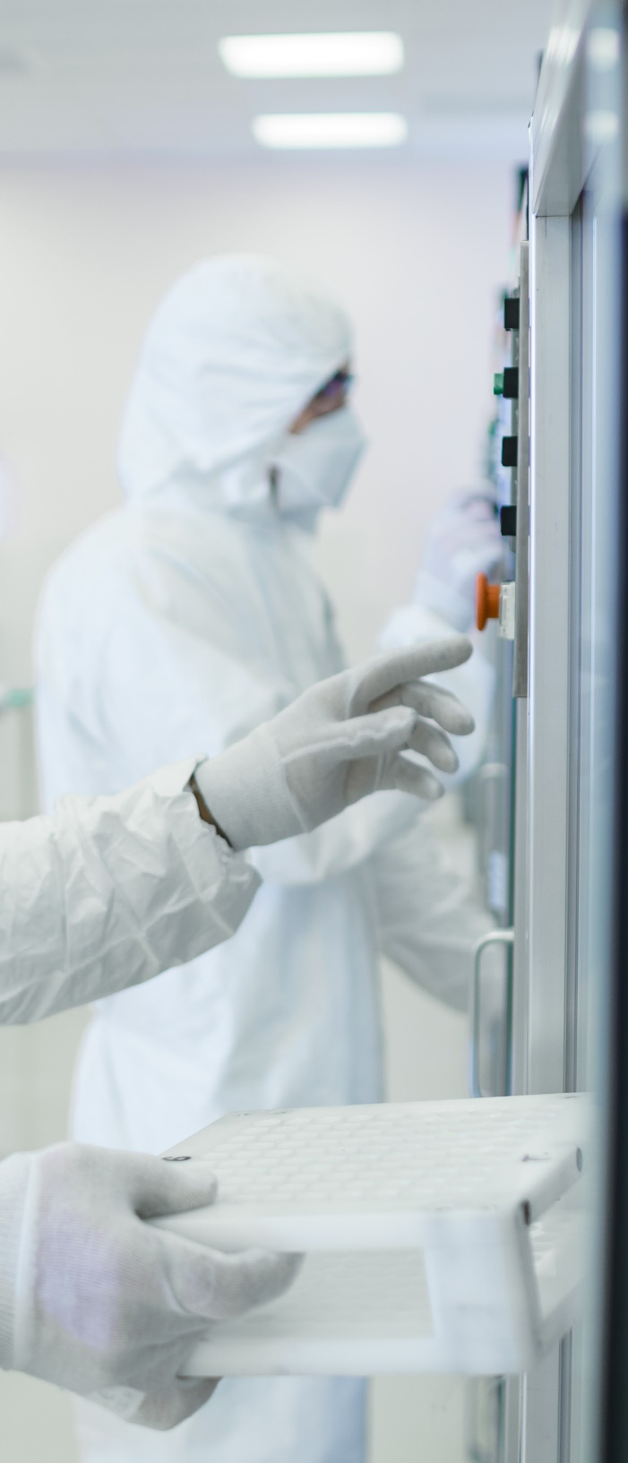
NXP CZECH REPUBLIC AT A GLANCE
30
Years History in the Czech republic
4
Locations
Ostrava, Roznov p.R., Brno, Zlin
500
Employees
30+
R&D Teams

Slide 4
Our target markets
Corporate Overview
Automotive
Industrial & IoT
Mobile
Solutions to complex autonomy, connectivity and electrification challenges for today’s safe and secure vehicles.
Simplified machine learning solutions that automate better decision-making at the device level for industry 4.0 applications.
Solutions for connected lifestyles that allow data to move more freely, transact more safely and connect more easily.
A smarter world starts with NXP
Smart Home
Smart City
Communication Infrastructure
Innovative IoT solutions that listen, learn and transform living spaces into personalized, intelligent environments.
Seamless and secure payment, controlled access, ID and ticketing solutions for managing city life.
5G-connected, edge computing technologies that support scalable communication networks.

Slide 5
2022 environmental, social, and governance (ESG) highlights
Environmental
Social
Governance and economic impact
Sustainability
Developed roadmaps for carbon neutrality and water recycling
97% Favorability from Winning Culture Survey respondents
AAA MSCI ESG rating
9% Decrease in normalized scope 1 & 2 emissions from 2021
35% Renewable electricity use
2+ Percentage-point increase of women team members R&D and executive positions
2 Percentage-point increase of US underrepresented minority representation
$1B USD Green innovation bond
Added a sustainability component to our short-term annual incentive plan for all employees
Joined the Semiconductor Climate Consortium as a founding member
48% of wastewater recycled
Of US new college graduate hires, 35% were women and 66% were underrepresented minorities
19 Employer award and recognitions form 10 countries
Published NXP’s first human rights policy
99% of wastewater recycled
83% of waste recycled
11% Decrease in hazardous waste
Maintained a low total case incident rate (TCIR) of 0.10
Published NXP’s first extended minerals reporting template (EMRT)
King Willem I award for sustainable entrepreneurship
KLM Royal Dutch Airlines sustainability award

Slide 6
NXP EMPLOYER BENEFITS
Receive a competitive compensation package
Get the opportunity to participate in company social events
Take part in career development opportunities, such as:
Many internal and external technical and soft-skill trainings
Create your own career in 3 paths:
Technical
Managerial or
Project management
Engage in employee resource groups
No eXtra Planet: environmental sustainability
Any many more
Arrange a flexible work schedule
Engage with an energizing, international work environment
Have an opportunity to set up a home office
Received additional vacation days
Participate in sport & leisure activities
Work with industry experts and cutting-edge technology
AND MUCH MORE!
Get an opportunity to shape and contribute to the future of sustainable development
Notes:
Please check and adjust if there are any benefits mismatch your local practice.

Slide 7
NXP Thesis
Level | Topic | UNI | Technical Lead
Bc. | Object Detection on the i.MX RT Microcontroller (nxp Marina Kravchuk) | VUT FIT | David Piskula
ing | Problematika prechodu na SPA (nxp Jirka Vanicek) | Mendelu | Ondra Balas
Ing. | High Performance Lookup Algorithms for Ethernet (NXP - Tomas Guzma) | Zlin | Ondrej Spacek
Bc. | Porovnání knihoven pro vzdálené volání procedur (Ondřej Sedláček) | FAI Zlin | Michal Princ
Ing. | Rust support for eRPC library (NXP Marek Misik) | MUNI | Michal Princ
Ing. | TCP/IP stacks comparison on NXP MCU processors (Oliver Šintaj) | MU | Stanislav Pobořil
Bc. | Evidencia hardwaru pomocou QR kódov (Tereza Hrbkova) | MU | Samuel Mudrik
Ing. | fuzz testovani a moznosti jeho vyuziti pri vyvoji sw (NXP – Pavlina Kulhava) | Zlin | Samuel Mudrik
Bc. | Electric Motor Diagnostic Test Tool with Temperature and Humidity Measurement (NXP – Jan Mazoch) | VSB FEI | Jaroslav Lepka
Ing. | Compatibility of NXP processors with Arduino IDE (Jan Tomocek) | VUT | Petr Hradsky
Bc. | Automatická tvorba diagramů časování (Jindřich Dítě) | VUT | Petr Hradsky
Currently we have ~11 topics in progress
Bachelor’s and diploma thesis
NXP engineers as consultants
We are interested in Ph.D. students' support
Define your own
We are open to proposal of a thesis topic.
The topic must be related to NXP projects or technologies.

Slide 8
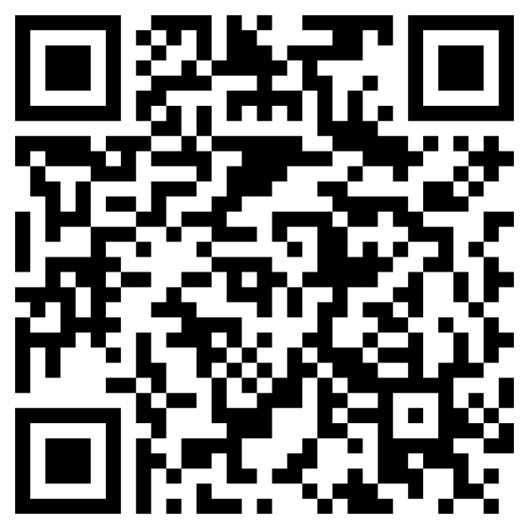
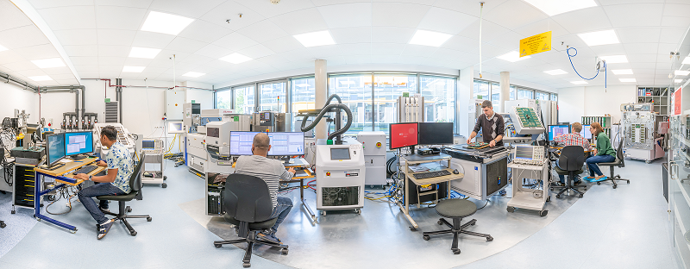
NXP Internships
Photos of your awards/ National Flag / etc.
11 open internships in Q4/24
20 internship in Q1/Q2 2025
Embedded Software Developer – Student
Ethernet SW developer
SW Student Config Tools
Intern SW Quality
Embedded SW – Libraries/Stacks SW Intern
System enablement intern
Notes:
Sample of overview of your region/country/site introduction

Slide 9
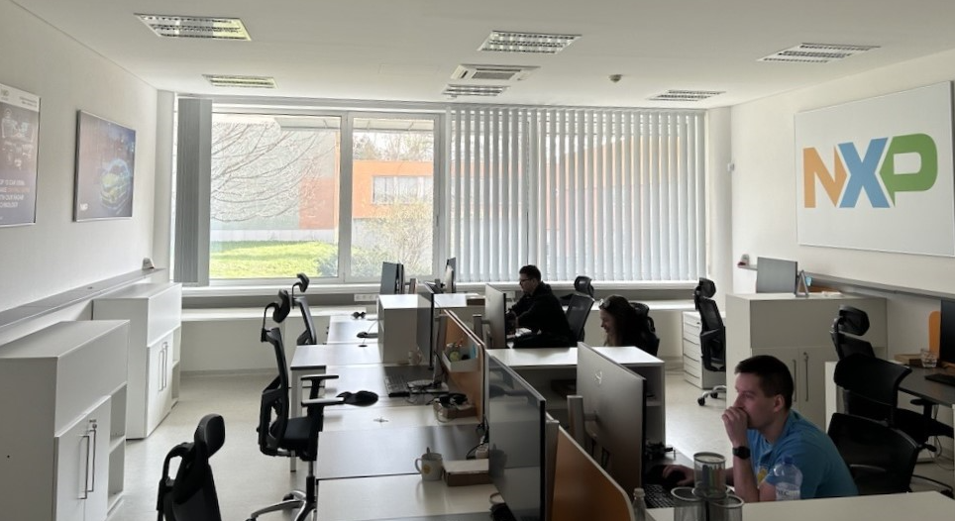
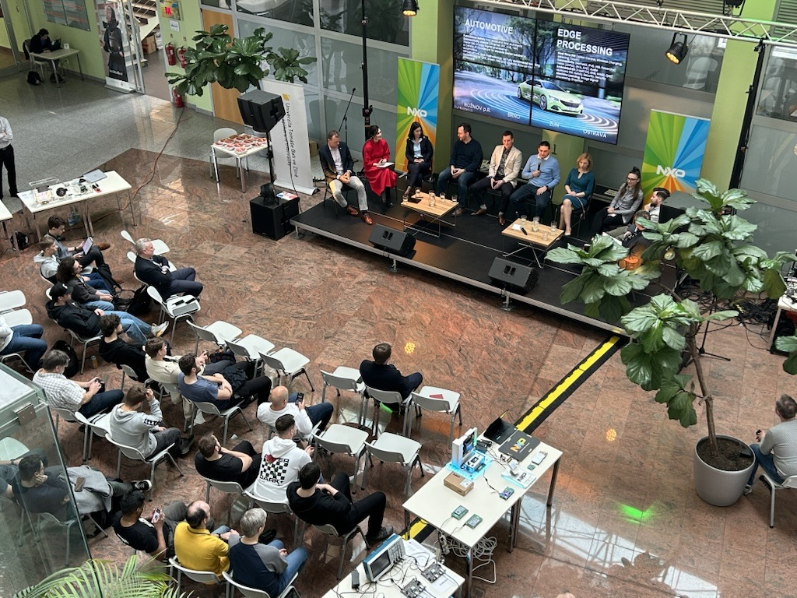
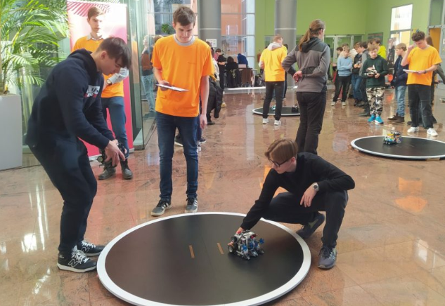
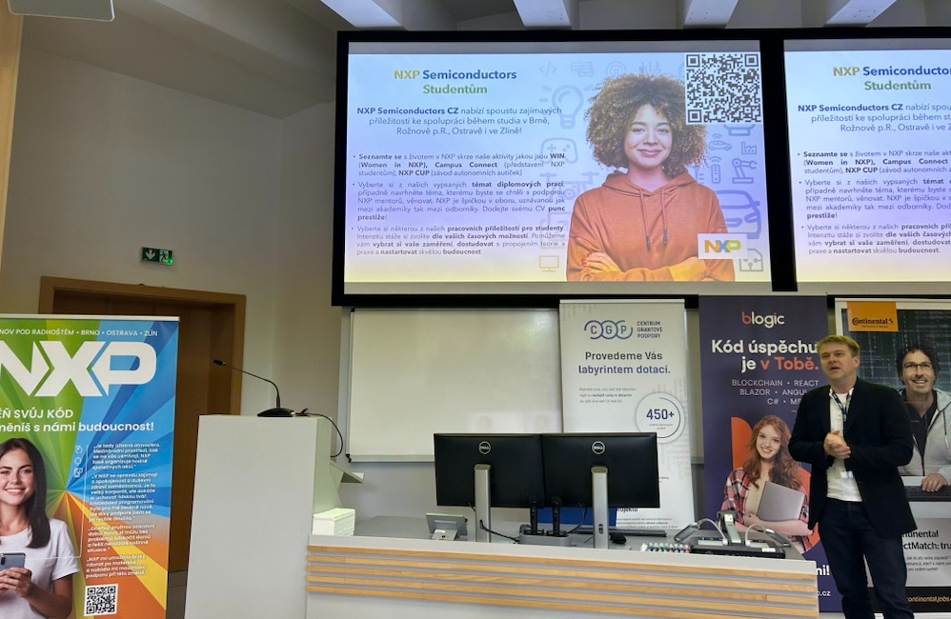
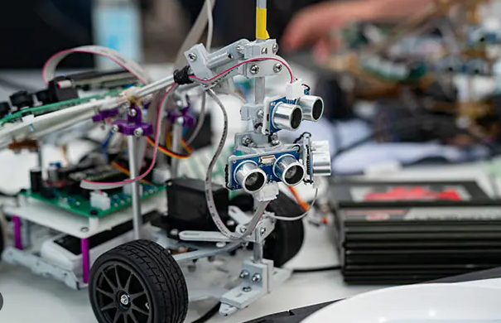
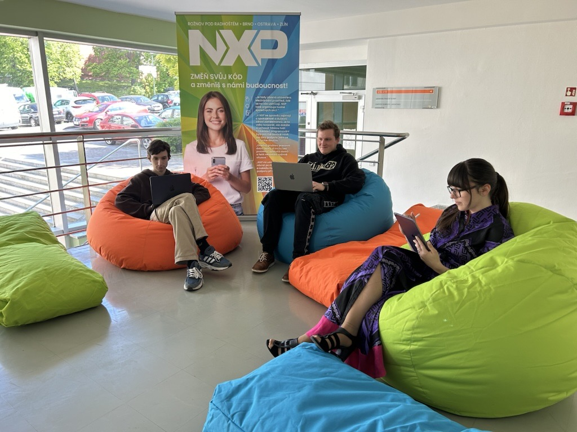
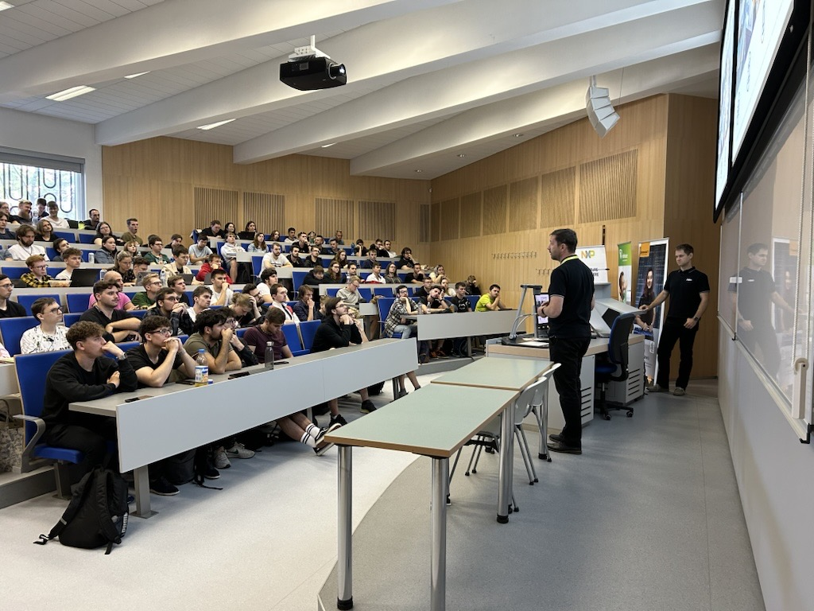
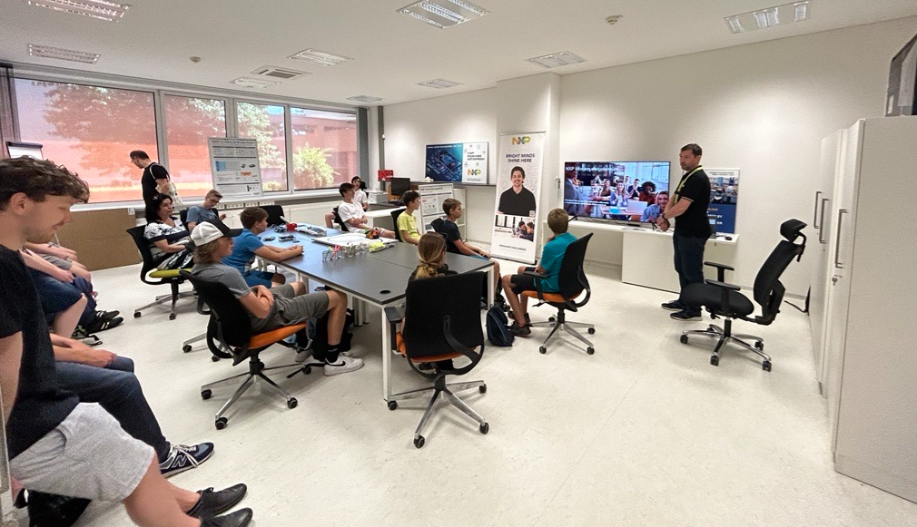
NXP Tech talk
What was done
Activities organized or supported by NXP with University 2023 - 2024
Office foundation :
2 Rooms rented in June 2023 with capacity 115m²
- 1st room NXP office
-
2nd room NXP showroom (used for meetings, workshops and propagation)
Robo games
STOČ
NXP CUP
Chill zone
Workshops / Lectures

Slide 10
Thank you!

