Slide 2
FACULTY PROFILE
Educational Activities
Bachelor´s Degree Studies
Master´s Degree Studies
Doctoral Degree Studies
Research and Development Activities
Information Technologies
Automatic Control
Security Technologies

Slide 3
FACULTY HISTORY
1986 – 1992 Department of Automation and Control Engineering
1992 – 2001 Department of Automation and Control Systems
2001 – 2004 Institute of Information Technologies (2 Departments)
2004 – 2005 Institute of Process Control and Applied Informatics (4 Departments)
2006 Faculty of Applied Informatics

Slide 4
FACULTY STRUCTURE
Department of Electronics and Measurements
Department of Mathematics
Department of Informatics and Artificial Intelligence
Department of Computer and Communication Systems
Department of Automation and Control Engineering
Department of Process Control
Department of Security Engineering
Regional Research Centre CEBIA-Tech
The Information and Communication Technologies Scientific Research Park

Slide 5
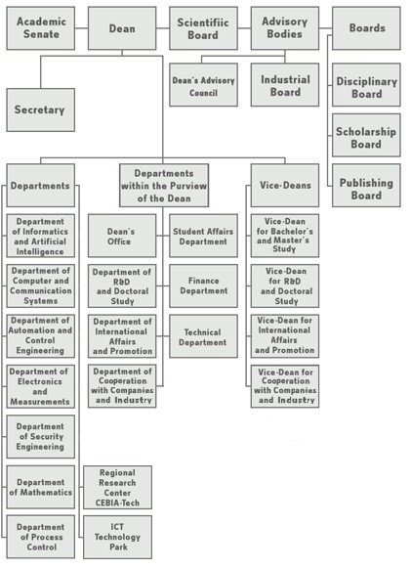
FACULTY STRUCTURE

Slide 6
PERSONNEL STRUCTURE
Employee Categories | As of: 1.1.2010 | As of: 1.1.2011 | As of: 1.1.2012 | As of: 1.1.2013 | As of: 1.1.2014 | As of: 1.1.2015 | As of: 1.1.2016 | As of: 1.1.2017 | As of: 1.1.2018 | As of: 1.1.2019 | As of: 1.1.2020
Academic staff | 72 | 75 | 77 | 78 | 77 | 76 | 75 | 74 | 76 | 76 | 77
Research staff | 9 | 8 | 8 | 6 | 9 | 10 | 11 | 13 | 15 | 15 | 16
Administrative staff | 26 | 36 | 30 | 41 | 39 | 42 | 45 | 45 | 41 | 41 | 36

Slide 7
PERSONNEL STRUCTURE
 | As of: 1.1.2010 | As of: 1.1.2011 | As of: 1.1.2012 | As of: 1.1.2013 | As of: 1.1.2014 | As of: 1.1.2015 | As of: 1.1.2016 | As of: 1.1.2017 | As of: 1.1.2018 | As of: 1.1.2019 | As of: 1.1.2020
Total employees | 115 | 115 | 126 | 125 | 128 | 131 | 132 | 128 | 132 | 132 | 129

Slide 8
PERSONNEL STRUCTURE
Academic staff | As of: 1.1.2010 | As of: 1.1.2011 | As of: 1.1.2012 | As of: 1.1.2013 | As of: 1.1.2014 | As of: 1.1.2015 | As of: 1.1.2016 | As of: 1.1.2017 | As of: 1.1.2018 | As of: 1.1.2019 | As of: 1.1.2020
Professors | 7 | 8 | 8 | 8 | 9 | 9 | 8 | 8 | 7 | 7 | 7
Associate Professors | 16 | 14 | 14 | 14 | 15 | 14 | 14 | 13 | 15 | 15 | 17
Assistant Professors | 33 | 38 | 43 | 43 | 42 | 43 | 43 | 44 | 42 | 42 | 41
Assistants | 13 | 11 | 8 | 7 | 6 | 6 | 6 | 6 | 9 | 9 | 11
Lecturers | 6 | 6 | 5 | 5 | 4 | 3 | 3 | 2 | 2 | 2 | 1
Research Assistants | 8 | 8 | 6 | 9 | 10 | 11 | 13 | 15 | 15 | 15 | 16

Slide 9
FACULTY BUDGET 2009 - 2019
CZK (Million) | 2009 | 2010 | 2011 | 2012 | 2013 | 2014 | 2015 | 2016 | 2017 | 2018 | 2019
Overall Government Allocation | 96,3 | 81,9 | 84,3 | 71,79 | 69,74 | 77,57 | 70,69 | 70,89 | 68,06 | 71,94 | 75,42
Contribution to University Budget | 24,7 | 22,3 | 21,5 | 20,41 | 17,8 | 21,2 | 21,45 | 19,46 | 20,33 | 25,52 | 26,29
Clear Funding from Government | 71,9 | 61,4 | 62,8 | 51,38 | 51,94 | 56,37 | 49,24 | 51,43 | 47,73 | 46,41 | 49,13
Other Sources of Revenue | 27,4 | 25,1 | 82,7 | 86,72 | N/A | N/A | N/A | N/A | 42,10 | 44,61 | 41,79

Slide 10
FACULTY BUDGET in 2019
CZK (Million) | 2019
Overall Government Allocation: | 75,42
Contribution to University Budget: | 26,29
Clear Funding from Government: | 49,13
Other Sources of Revenue: | 41,79
Faculty budget in 2019

Slide 11
FACULTY´s PEDAGOGICAL FOCUS
Bachelor´s Degree Studies 3-years
Master´s Degree Studies 2-years
Ph.D. (Doctoral) Degree Studies 4-years
ECTS Credit System
The Bologna Declaration

Slide 12
STUDENT NUMBERS
 | As of: 31.10.
 | 2008 | 2009 | 2010 | 2011 | 2012 | 2013 | 2014 | 2015 | 2016 | 2017 | 2018 | 2019
Bachelor´s Degree stud. programmes | 1197 | 1089 | 1112 | 972 | 915 | 963 | 987 | 842 | 754 | 784 | 778 | 914
Master´s Degree stud. programmes | 528 | 554 | 648 | 664 | 591 | 535 | 480 | 489 | 513 | 474 | 418 | 406
Ph.D. (Doctoral) Degree stud. programmes | 114 | 143 | 127 | 132 | 125 | 121 | 134 | 136 | 143 | 122 | 113 | 97
Total | 1 839 | 1 786 | 1 887 | 1 768 | 1 631 | 1 619 | 1 601 | 1 467 | 1 410 | 1 380 | 1 309 | 1 417

Slide 13
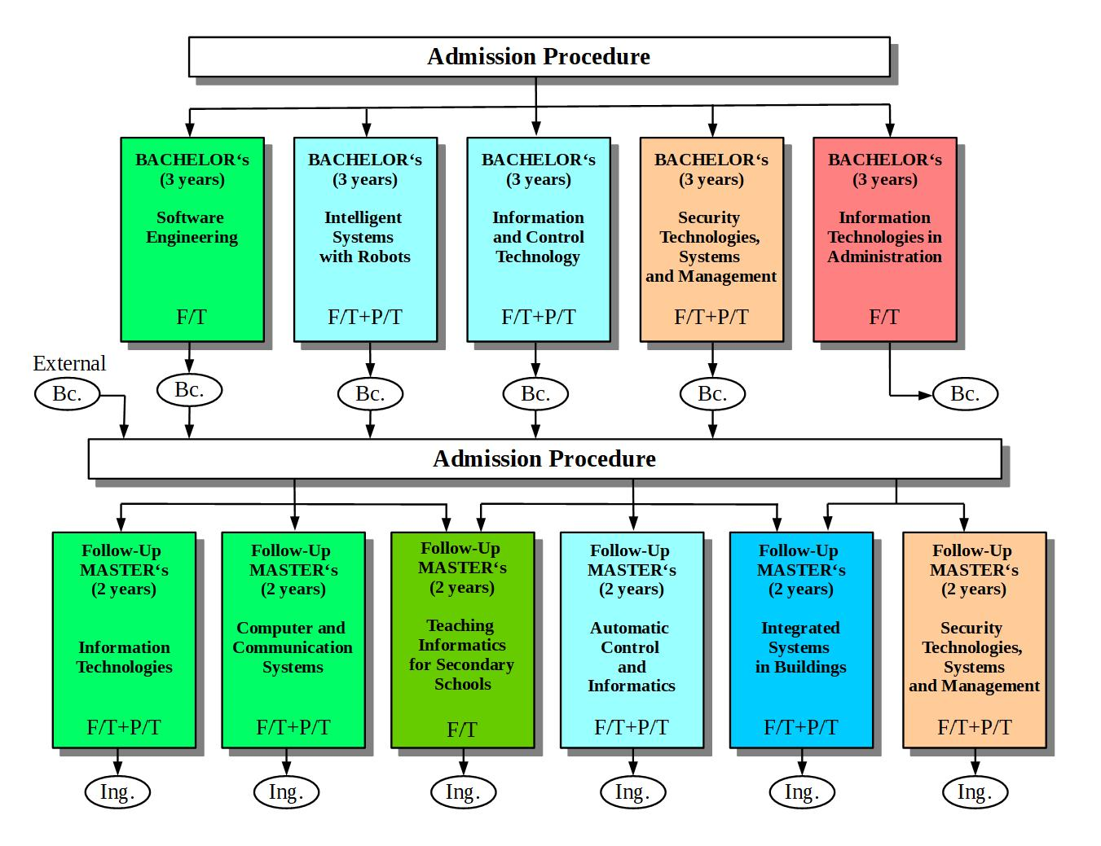
STUDY DISCIPLINE SCHEME (Bc. Ing.)

Slide 14
Ph.D. STUDIES DIAGRAM
Study Programmes
Fields of Studies
First students accepted as of June, 2008
Accreditation by 31. 8. 2019

Slide 15
Developments in Ph.D. Student Numbers (As of: 31.10. of the given year)
 | 2019 | 2018 | 2017 | 2016 | 2015 | 2014 | 2013 | 2012
Overall Ph.D. student numbers at FAI | 97 (15*) | 111 (9*) | 123 (10) | 143 (10) | 136 (6) | 135 (2) | 121 | 115
Full-time mode of study | 31 (9) | 31 (5) | 47 (4) | 61 (3) | 60 (3) | 65 (1) | 63 | 62
Part-time mode of study | 66 (6) | 80 (4) | 76 (6) | 82 (7) | 76 (3) | 70 (1) | 58 | 53
* Numbers in brackets show Foreign Ph.D. Student numbers
 | 2019 | 2018 | 2017 | 2016 | 2015
Degree Course: Automatic Control and Informatics | 14 (1) | 16 (1) | 21 (1) | 26 | 28
Full-time mode of study | 1 (1) | 4 (1) | 8 (1) | 11 | 12
Part-time mode of study | 13 (0) | 12 (0) | 13 | 15 | 16
 | 2019 | 2018 | 2017 | 2016 | 2015
Degree Course: Engineering Informatics | 83 (14) | 96 (8) | 102 | 117 | 108
Full-time mode of study | 30 (8) | 28 (4) | 39 (3) | 50 | 48
Part-time mode of study | 53 (6) | 68 (4) | 63 (6) | 67 | 60

Slide 16
Number of Accepted FAI Ph.D. Students
 | 2019/20 | 2018/19 | 2017/18 | 2016/17 | 2015/16 | 2014/15
Overall Ph.D. student numbers at FAI | 18 (8*) | 18 (2*) | 19 (2*) | 30 (6) | 31 (5) | 37 (2)
Full-time mode of study | 12 (7) | 5 (2) | 10 (2) | 19 (2) | 12 (2) | 25 (1)
Part-time mode of study | 6 (1) | 13 (0) | 9 (0) | 11 (4) | 19 (3) | 12 (1)
* Numbers in brackets show Foreign Ph.D. Student numbers
 | 2019/20 | 2018/19 | 2017/18 | 2016/17 | 2015/16 | 2014/15
Degree Course: Automatic Control and Informatics | 0 | 1 (1) | 1 (0) | 2(1) | 5(1) | 8
Full-time mode of study | 0 | 1 (1) | 0 | 2(1) | 2 | 5
Part-time mode of study | 0 | 0 | 1 (0) | 0 | 3(1) | 3
 | 2019/20 | 2018/19 | 2017/18 | 2016/17 | 2015/14 | 2014/15
Degree Course: Engineering Informatics | 18 (8) | 17 (1) | 18 (2) | 28(5) | 26(4) | 29(2)
Full-time mode of study | 12 (7) | 4 (1) | 10 (2) | 17(1) | 10(2) | 20(1)
Part-time mode of study | 6 (1) | 13 (0) | 8 (0) | 11(4) | 16(2) | 9(1)

Slide 17
Developments in Ph.D. Studies Graduate Numbers
 | 2019 | 2018 | 2017 | 2016 | 2015 | 2014 | 2013 | 2012
Number of Ph.D. Graduates at FAI | 5 | 2 | 12 (0) | 5 (1*) | 6 (1) | 1 | 7 (1) | 6 (1)
Degree Course: Automatic Control and Informatics | 1 | 1 | 2 | 1 | 2 (1) | 1 | 2 | 1
Degree Course: Engineering Informatics | 4 | 1 | 10 | 4 (1) | 4 | 0 | 5 (1) | 5 (1)
* Numbers in brackets show Foreign Ph.D. Student numbers
Overall Number of FAI Ph.D. Graduates | 1991 - 2019
Overall Number of Ph.D. Students Accepted | 93
Number of Ph.D. Students unsuccessful in completing their degree | 486
Totall successful of Ph.D. Students | 282
Overall Number of FAI Ph.D. Graduates | 24,8%

Slide 18
Dissertation Topics
Modern Information Technology Applications
Information System Software and Hardware Solutions
Artificial Intelligence Application Methods
Communication and Security Systems
Data Security
Critical Infrastructure Protection
Modern Automatic Control Methods
Manufacturing Processes and Systems Modelling and Simulation
Study Programme Information Technologies - https://fai.utb.cz/en/research-and-development/ph-d-studies/dissertation-topics-2020-2021/study-programme-information-technologies/
Study Programme Automatic Control and Informatics - https://fai.utb.cz/en/research-and-development/ph-d-studies/dissertation-topics-2020-2021/study-programme-automatic-control-and-informatics/

Slide 19
Dissertation Topics
Study Programme Security Technologies, Systems and Management - https://fai.utb.cz/en/study-programme-security-technologies-systems-and-management/

Slide 20
Student Grant Competition
(Internal Grant Agency – IGA)
The Internal Grant Agency assures the distribution of direct financial support for specific Tertiary Education research
The principles governing the distribution of these direct financial support grants are given in: Rector´s Directive SR/02/2018 (only in Czech available)

Slide 21
Developments in IGA Direct Support Grant Levels
IGA Direct Support Grant Levels for Specific Tertiary Education Research (In thou. CZK)

Slide 22
International Activities
Student + Academic Mobility
Study Stays
Outgoing
Incoming
Practical Work Placements
Outgoing
Incoming
Bilateral Contracts
Long-term Foreign Students

Slide 23
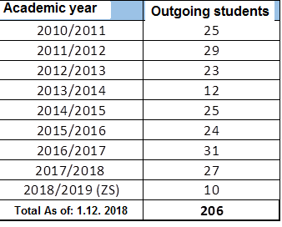
Outgoing Students
Outgoing Student Numbers (Study-stays/Work-Placements)
Academic year | Výjezdy-studenti
2011/2012 | 29
2012/2013 | 23
2013/2014 | 12
2014/2015 | 25
2015/2016 | 24
2016/2017 | 31
2017/2018 | 27
2018/2019 | 20
2019/2020 (WS) | 8
Celkem k 1. 1. 2020 | 199

Slide 24
Destinations

Slide 25
Incoming Students
Incoming Students (Study-stays/Work-Placements)

Slide 26
Overview of Countries of Origin

Slide 27
Bilateral Contracts
Overall Number of Bilateral Contracts Concluded Within the Erasmus+ Programme, as of: 1.1.2020 - 85

Slide 28
Bilateral contracts
Overall Number of Bilateral Contracts Concluded Within the Erasmus+ Programme, as of: 1.1.2020 - 85

Slide 29
Bilateral Contracts
Overall Number of Bilateral Contracts Concluded Within the Erasmus+ Programme, as of: 1.1.2020 - 85

Slide 30
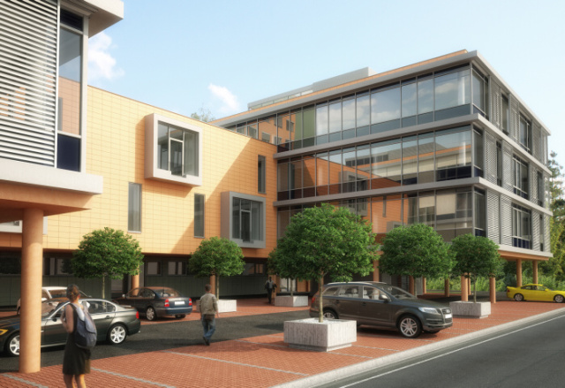
ICT TECHNOLOGY PARK
INFORMATION AND COMMUNICATION TECHNOLOGIES

Slide 31
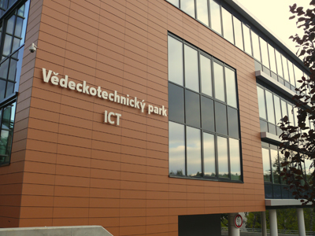
ICT TECHNOLOGY PARK
Information about the Technology Park of Information and Communication Technology
Grant Provider: MPO ČR
Operational program: Enterprise
and Innovation
Grant title: Prosperita II.
Construction begun: 03/2011
Construction finished: 09/2012
Usable surface area: 3617.47 m²
Overall usable surface area: 5006.39 m²
Financial costs: cca 280 mill. CZK
Finance sourcing: ¾ grant from MPO, Czechinvest
¼ TBU in Zlín

Slide 32
ICT TECHNOLOGY PARK
ICT park – další cíle a přínosy
Continuously fulfill the development of cooperation between the university environment and the business sphere.
To support the development of the competitiveness of companies and their products.
Create job positions for qualified graduates and students in innovative companies.
Fulfill the synergy of VTP - ICT and RVC CEBIA-Tech by close cooperation on real problems.
Involve companies in FAI pedagogical activities - teaching, lectures…
Involve companies in professional activities of FAI students - guiding students on projects, active participation in STOČ…

Slide 33
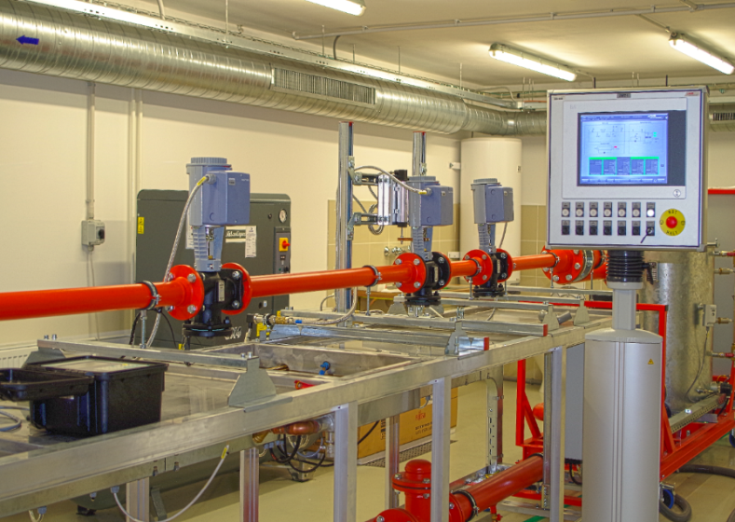
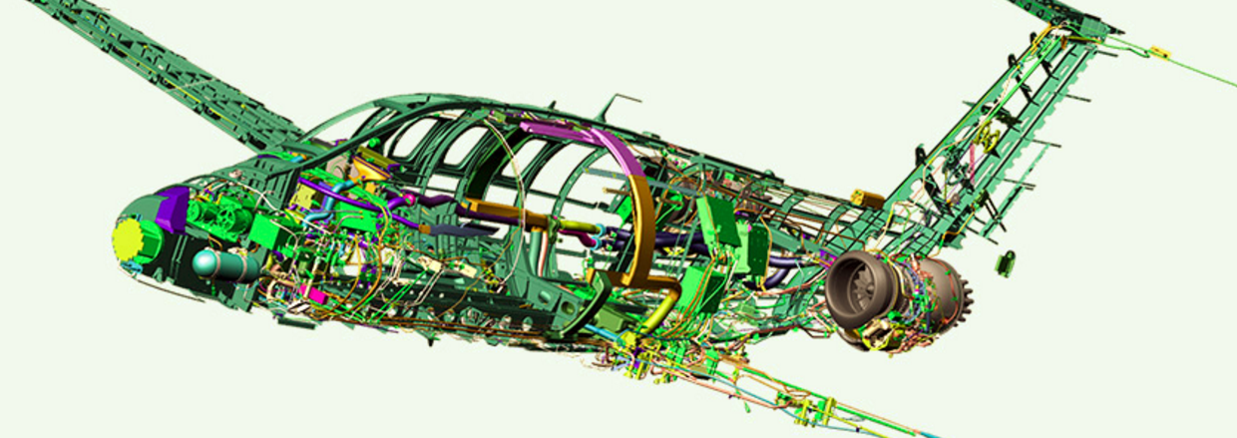
Regional Research Center
CEBIA-Tech
RVC CEBIA-Tech was built
based on the solution of the European project
Science and Research for Innovation
in the years 2011 - 2014, with financial support
of EU in the amount of CZK 174 million,
of which CZK 131 million
was used to build the infrastructure of the
center.
Further development of the center took placein the years 2014 - 2019
with EU financial support
(CZK 44 million), Ministry of Education, Youth and Sports
(CZK 40 million) and Center(FAI) itself
in the amount of CZK 60 million

Slide 34
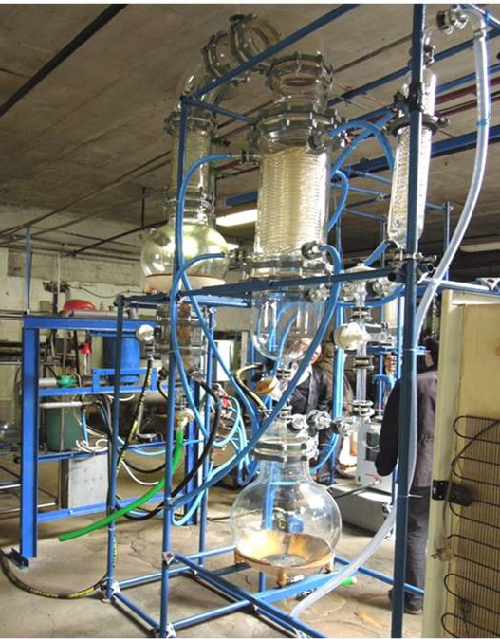
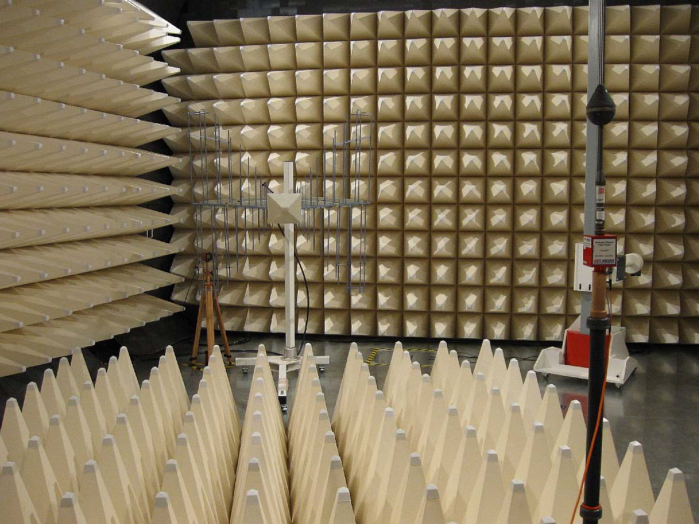
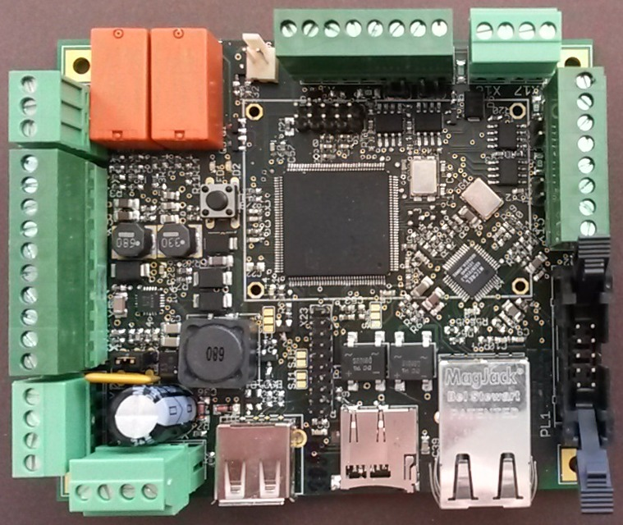
Regional Research Center
CEBIA-Tech

Slide 35
Regional Research Center
CEBIA-Tech
Regional Research Center (RVC) CEBIA-Tech, is an important part of the Faculty of Applied Informatics implementing scientific research activities in the following areas :
Industrial automation for intelligent production systems
Robotic and mechatronic systems
Theory of automatic control
Research amd development of embedded systems
Information technologies
Software engineering
applications of grid computing and artificial intelligence methods
Cybersecurity
Study of mechanical behavior of selected construction materials
Integrated systems in buildings
Small mobile networks
Forensic technologies
Electromagnetic compatibility
ICT for support of crisis management
Alternative energy resources
Advanced waste processing

Slide 36
Thank you for your kind attention.

